Slide 1
FrondEnd - Frameworks
Pravin Y Pawar

Slide 2
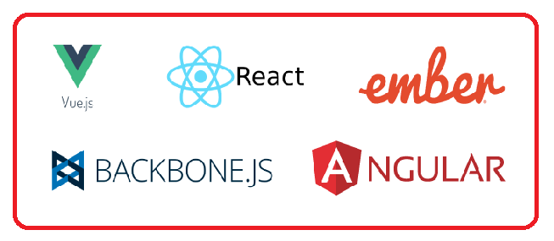
Why frameworks?
For frontend developers, it’s increasingly challenging to make up their minds about which JavaScript application framework to choose
especially when need to build a single-page application
Requirements
First, modern frontend JavaScript frameworks must respect the Web Components specification.
should have support for custom HTML elements building
Second, a solid JavaScript framework should have its own ecosystem
Ready solutions aim at solving various problems of client-side development such as
Routing
managing app state
communicating with the backend

Slide 3

React
Stormed the JS world several years ago to become its definite leader
Encourages to use a reactive approach and a functional programming paradigm
Introduced many of its own concepts to define its unique approach to frontend web development
Need to master a component-based architecture, JSX, and unidirectional data flow
Ecosystem:
The React library itself plus React-DOM for DOM manipulation
React-router for implementing routes
JSX, a special markup language that mixes HTML into JavaScript
React Create App, a command line interface that allows you to rapidly set up a React project
Axios and Redux-based libraries, JS libraries that let you organize communication with the backend.
React Developer Tools for Chrome and Firefox browsers.
React Native for development of native mobile applications for iOS and Android.

Slide 4

Angular 2
Marks a turning point in the history of the Angular framework
Has substantially changed its architecture to come to terms with React
Is from a Model-View-Whatever architecture to a component-based architecture
Ecosystem:
A series of modules that can be selectively installed for Angular projects: @angular/common, @angular/compiler, @angular/core, @angular/forms, @angular/http, @angular/platform-browser, @angular/platform-browser-dynamic, @angular/router, and @angular/upgrade
TypeScript and CoffeeScript, supersets of JavaScript that can be used with Angular
Angular command line interface for quick project setup
Zone.js, a JS library used to implement zones, otherwise called execution context, in Angular apps
RxJS and the Observable pattern for asynchronous communication with server-side apps
Angular Augury, a special Chrome extension used for debugging Angular apps
Angular Universal, a project aimed at creating server-side apps with Angular
NativeScript, a mobile framework for developing native mobile applications for iOS and Android platforms

Slide 5

Vue
At first sight, it may look like the Vue library is just a mix of Angular and React
Borrowed concepts from Angular and React
For example,
Vue wants you to store component logic and layouts along with stylesheets in one file. That’s how React works without stylesheets
To let Vue components talk to each other, Vue uses the props and state objects - existed in React before Vue adopted it
Similarly to Angular, Vue wants you to mix HTML layouts with JavaScript
The VueJS ecosystem consists of:
Vue as a view library.
Vue-loader for components.
Vuex, a dedicated library for managing application state with Vue; Vuex is close in concept to Flux.
Vue.js devtools for Chrome and Firefox.
Axios and vue-resource for communication between Vue and the backend.
Nuxt.js, a project tailored to creating server-side applications with Vue; Nuxt.js is basically a competitor to Angular Universal.
Weex, a JS library that supports Vue syntax and is used for mobile development.

Slide 6

Ember
Like Backbone and AngularJS, is an “ancient” JavaScript framework
But the fact that Ember is comparatively old doesn’t mean that it’s out of date
Allows implement component-based applications just like Angular, React, and Vue do
One of the most difficult JavaScript frameworks for frontend web development
Realizes a typical MVC JavaScript framework, and Ember’s architecture comprises the following parts:
adapters, components, controllers, helpers, models, routes, services, templates, utils, and addons.
The EmberJS ecosystem includes:
The actual Ember.js library and Ember Data, a data management library.
Ember server for development environments, built into the framework.
Handlebars, a template engine designed specifically for Ember applications.
QUnit, a testing JavaScript framework used with Ember.
Ember CLI, a highly advanced command line interface tool for quick prototyping and managing Ember dependencies.
Ember Inspector, a development tool for Chrome and Firefox.
Ember Observer, public storage where various addons are stored. Ember addons are used for Ember apps to implement generic functionalities.

Slide 7

Backbone/Marionette
Is an MV* framework. Backbone partly implements an MVC architecture, as Backbone’s View part carries out the responsibilities of the Controller
Has only one strong dependency – the Underscore library that gives us many helper functions for convenient cross-browser work with JavaScript
Attempts to reduce complexity to avoid performance issues
The BackboneJS ecosystem contains:
The Backbone library, which consists of events, models, collections, views, and router
Underscore.js, a JavaScript library with several dozen helper functions that you can use to write cross-browser JavaScript
Underscore’s microtemplating engine for Backbone templates
BackPlug, an online repository with a lot of ready solutions (Backbone plugins) tailored for Backbone-based apps
Backbone generator, a CLI for creating Backbone apps
Marionette, Thorax, and Chaplin – JS libraries that allow you to develop a more advanced architecture for Backbone apps

Slide 8
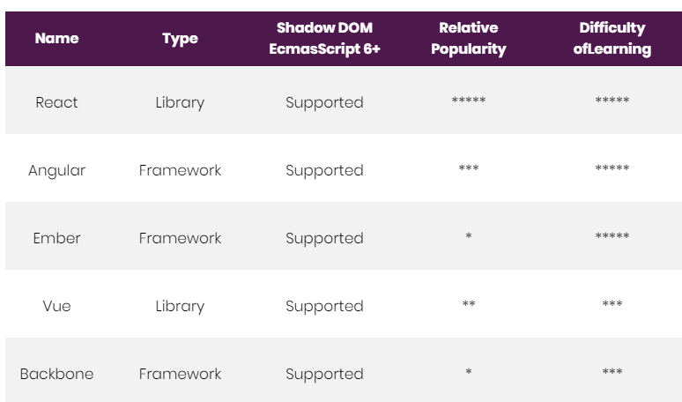
Compared
Source : RubyGarage

Slide 9
Thank You!
Reference : RubyGarage Blog
In our next session:

